Slide 1



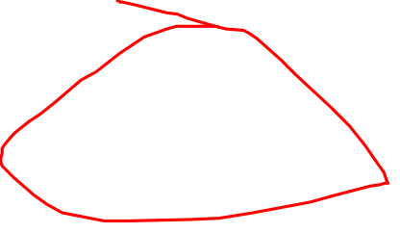
House price prediction
Ames Housing dataset

Slide 2



Slide 3
Price
Area
Utilities
Neighborhood
Class/Type
Quality
Safety
Parameters

Slide 4
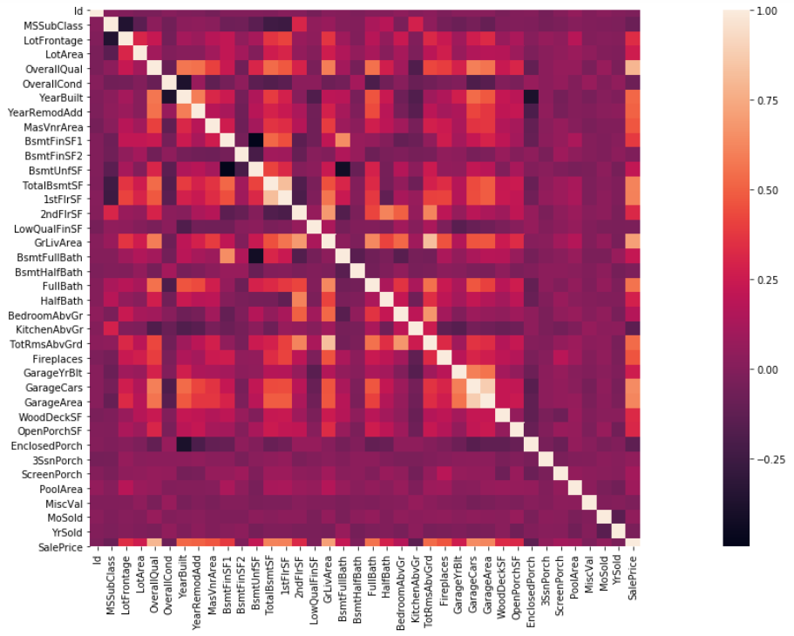

Correlation between Parameters

Slide 5
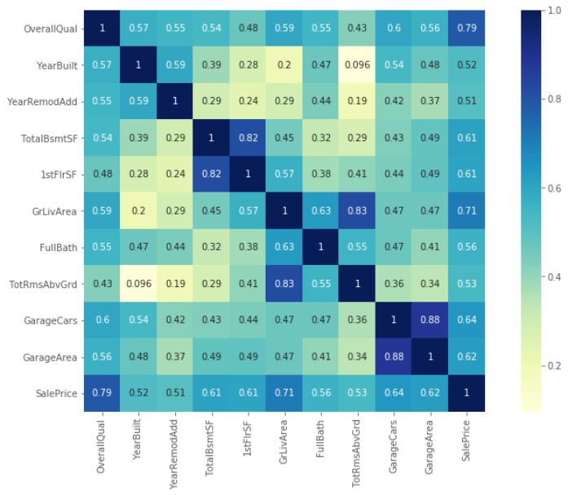

Highly correlated parameters

Slide 6


VS

Slide 7
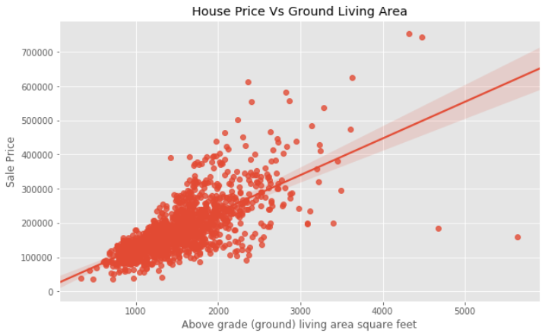



Slide 8

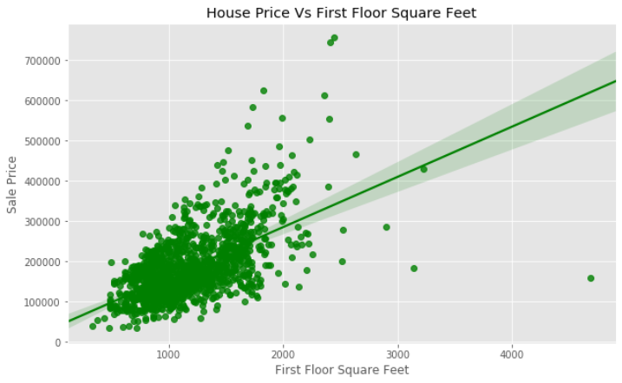


Slide 9
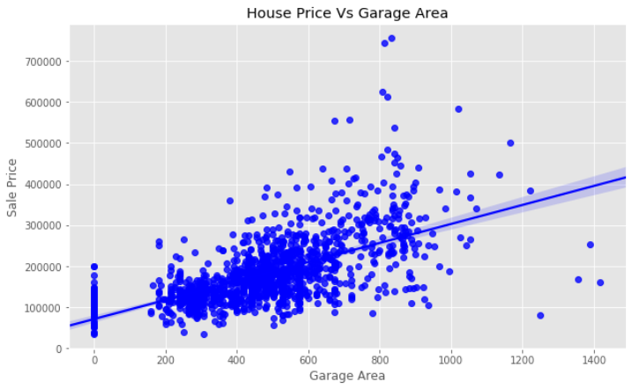
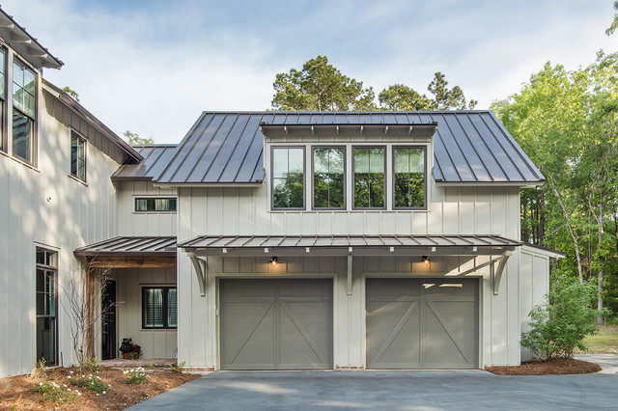


Slide 10

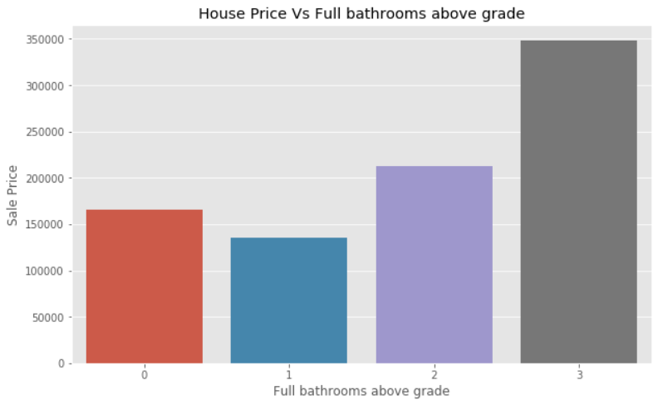


Slide 11
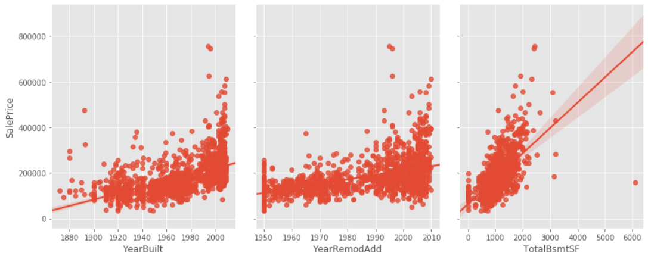

Slide 12


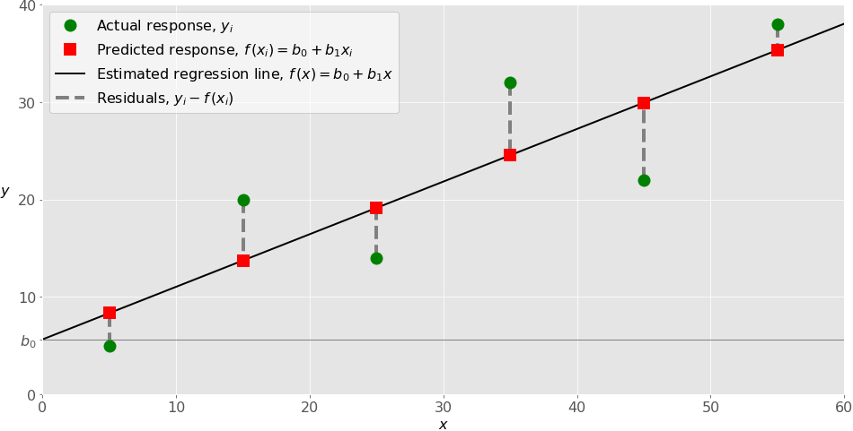


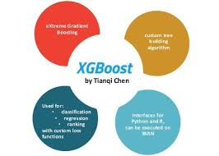

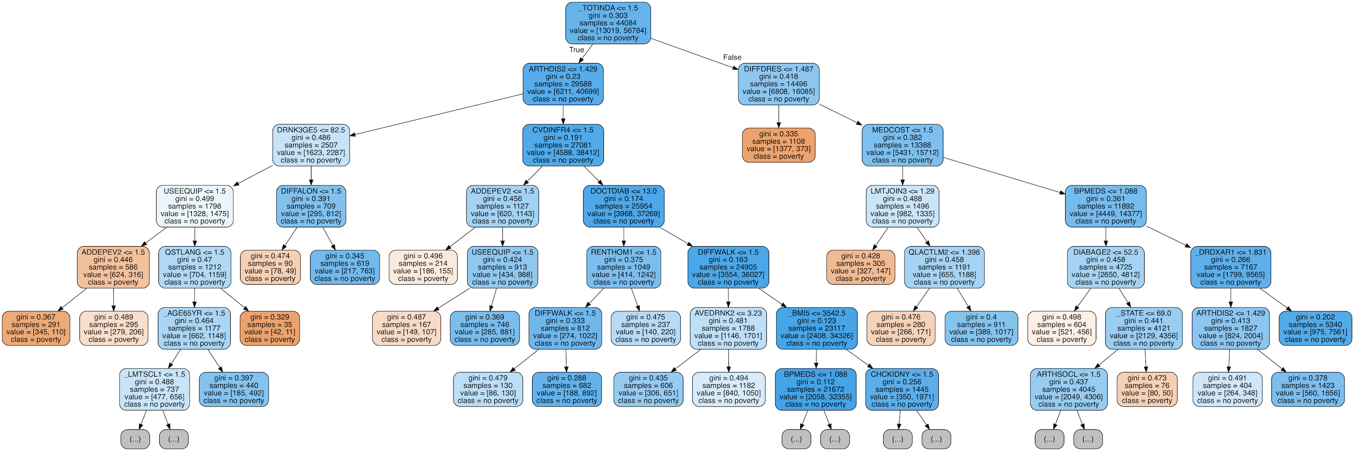


`

Slide 13
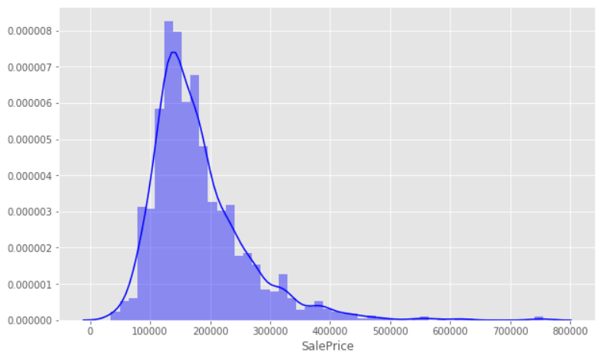
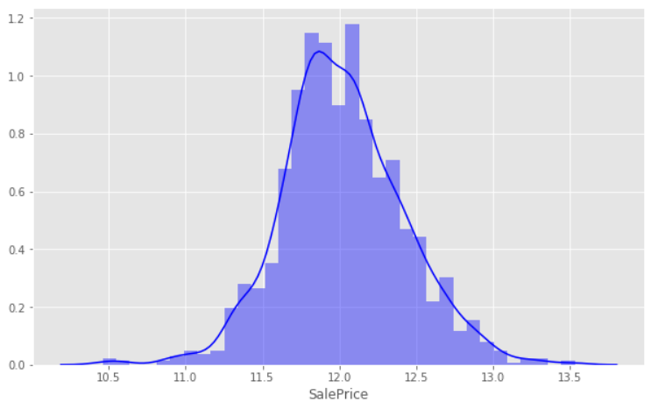
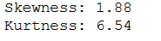
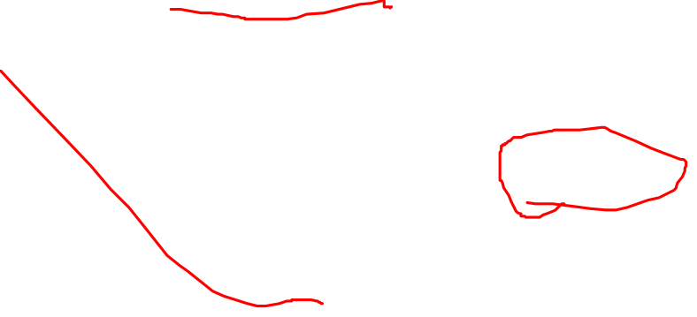
Sales Price Distribution
Log

Slide 14

Data Pre Processing

Slide 15


Dealing With Missing Data

Slide 16



Removing Outliers

Slide 17
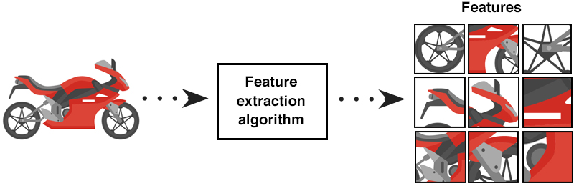
Feature Engineering

Slide 18
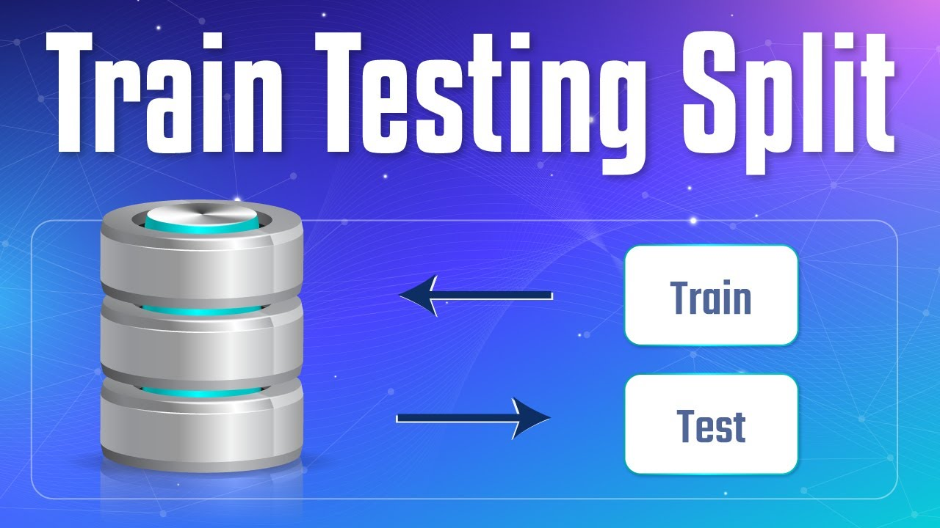
Train & Test

Slide 19
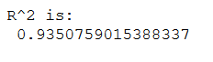
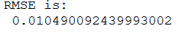
Linear Regression

Slide 20
XGBoost Algorithm
Public Score: 0.43190

Slide 21

Random Forest (Ensemble)
Public Score: 0.43190

Slide 22

Conclusion
It is better to apply multiple algorithms to get a better result.
Removing the Outliers increase the Accuracy.
Removing Highly Correlated variables decreases the Errors
Data Pre Processing is the Key factor to get a better value

Slide 23
Thank You

